Slide 1
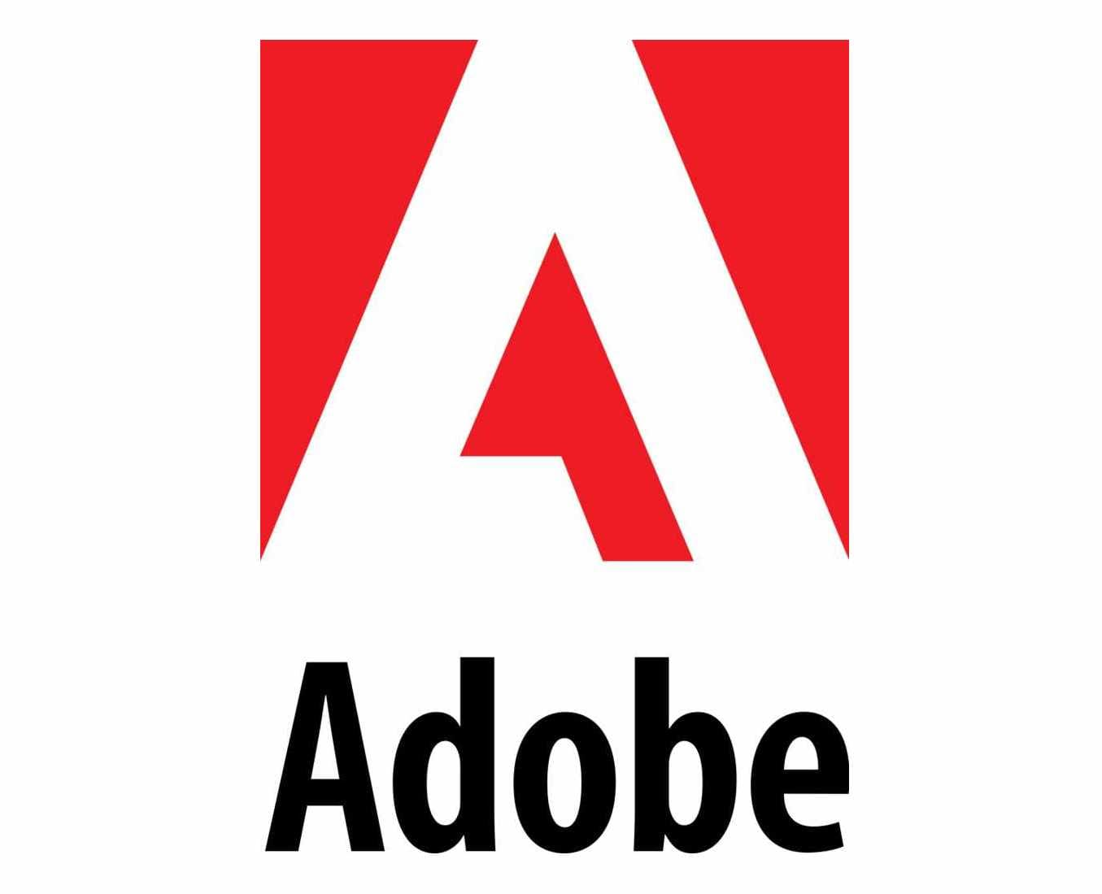
Adobe reader
Kaif Ahmed R

Slide 2
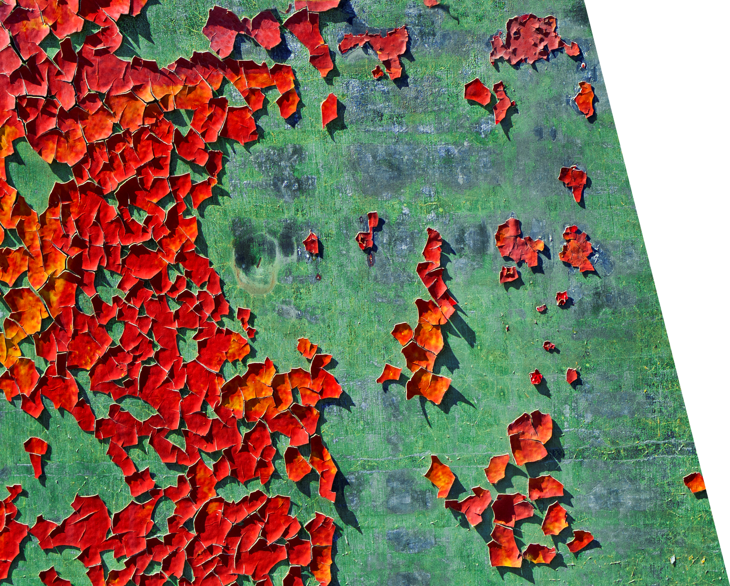
INTRODUCTION
Adobe Acrobat Reader DC software is the free, trusted global standard for viewing, printing, signing, sharing, and annotating PDFs. It's the only PDF viewer that can open and interact with all types of PDF content – including forms and multimedia. And now, it’s connected to Adobe Document Cloud services – so you can work with PDFs on any device, from anywhere

Slide 3

ADOBE READER PACKS

Slide 4
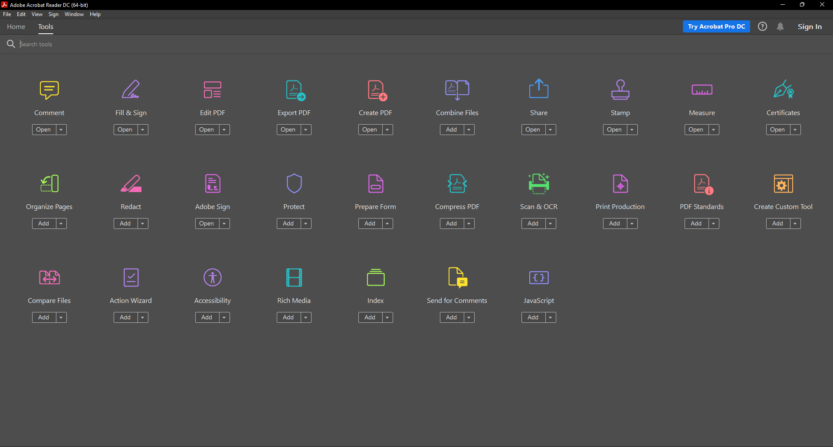
Features

Slide 5
Work Flow
Install Adobe Acrobat Reader software from our official website.
Now you are can view your PDFs and do anything with our documents on a single platform.
Right Click on a document and choose open with Adobe Acrobat Reader option

Slide 6


Commercial Advantages
Create PDF Files from almost anything. Windows 10 and macOS allow you to print just about anything as a PDF file through an integrated virtual printer. ...
Edit PDFs from a Single Platform. ...
Collaborate Easily. ...
Auto-Complete Documents. ...
Secure and Optimize PDFs.

Slide 7

THANK YOU
Kaif Ahmed R
Unknown@gmail.com

